Slide 1
Roslyn and its CI integration at Agoda

Slide 2


About Us
Krisztian Bodrogi
Breaking stuff, sometimes fixing those at Agoda.
Twitter: @master994
JOEL DICKSON
Development Manager at Agoda
NUnit core team Member
Coming to Thailand for 10 years for business
Originally from Australia, I live in Bangkok
I like Beer and Sport

Slide 3
What was the problem?
Poor reusability of code
Armature mistakes that get missed
Copy paste coding
Misuse of features
possibly leading to failure at runtime (production)
All of the above leads to
a code base that is hard to work on
Makes people’s jobs harder
More maintenance, less innovation
Overall lower execution from the development teams

Slide 4
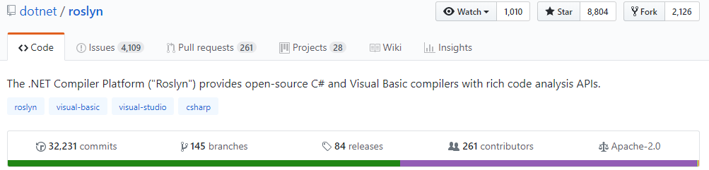
Some history
Notes:
What was the compiler before Roslyn? Input -> Output No visibility no way to add extra stuff to you build. There was no way you can actually perform any action during the build, have the meta data to make decessions.

Slide 5

What is Roslyn exactly?
Compiler Platform
Compile Metadata provider
Language service
Notes:
Reason : opening up the black boxes and allowing tools and end users to share in the wealth of information compilers have about our code.
IntelliSense, refactoring, intelligent rename, “Find all references,” and “Go to definition” to increase our productivity.

Slide 6
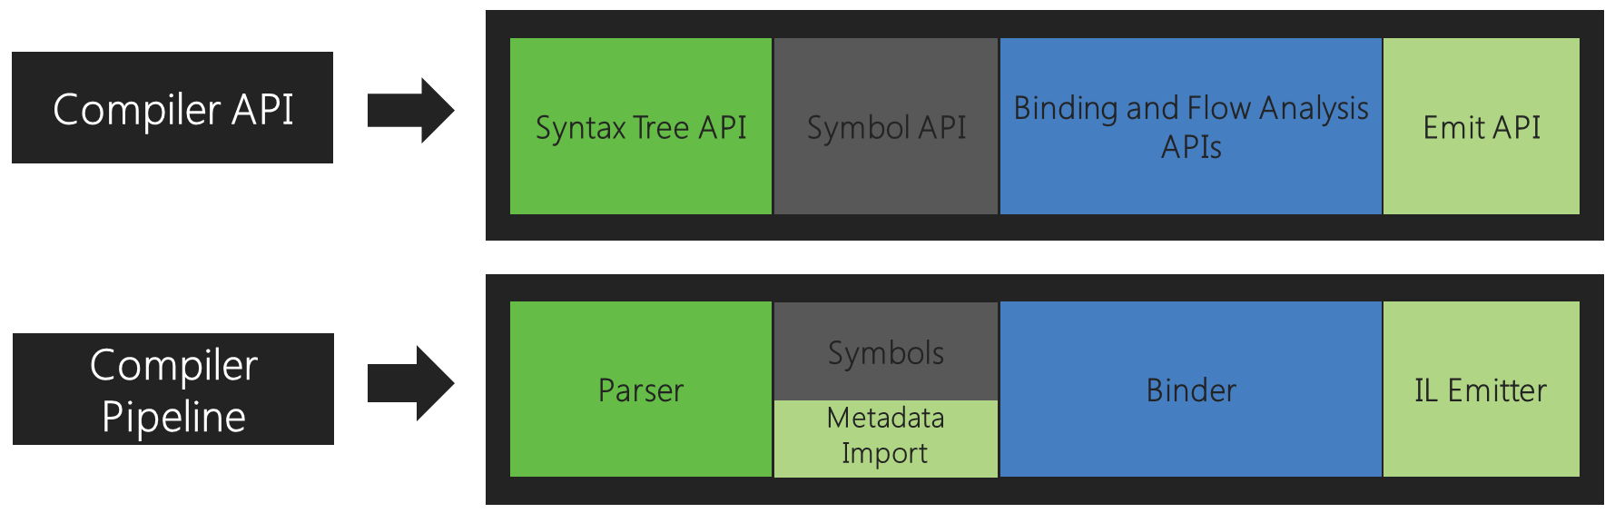
The .NET Compiler Platform ("Roslyn")
Notes:
tokenized and parsed into syntax that follows the language grammar
Declarations from source and imported metadata are analyzed to form named symbols
Identifiers in the code are matched to symbols
Code emit

Slide 7
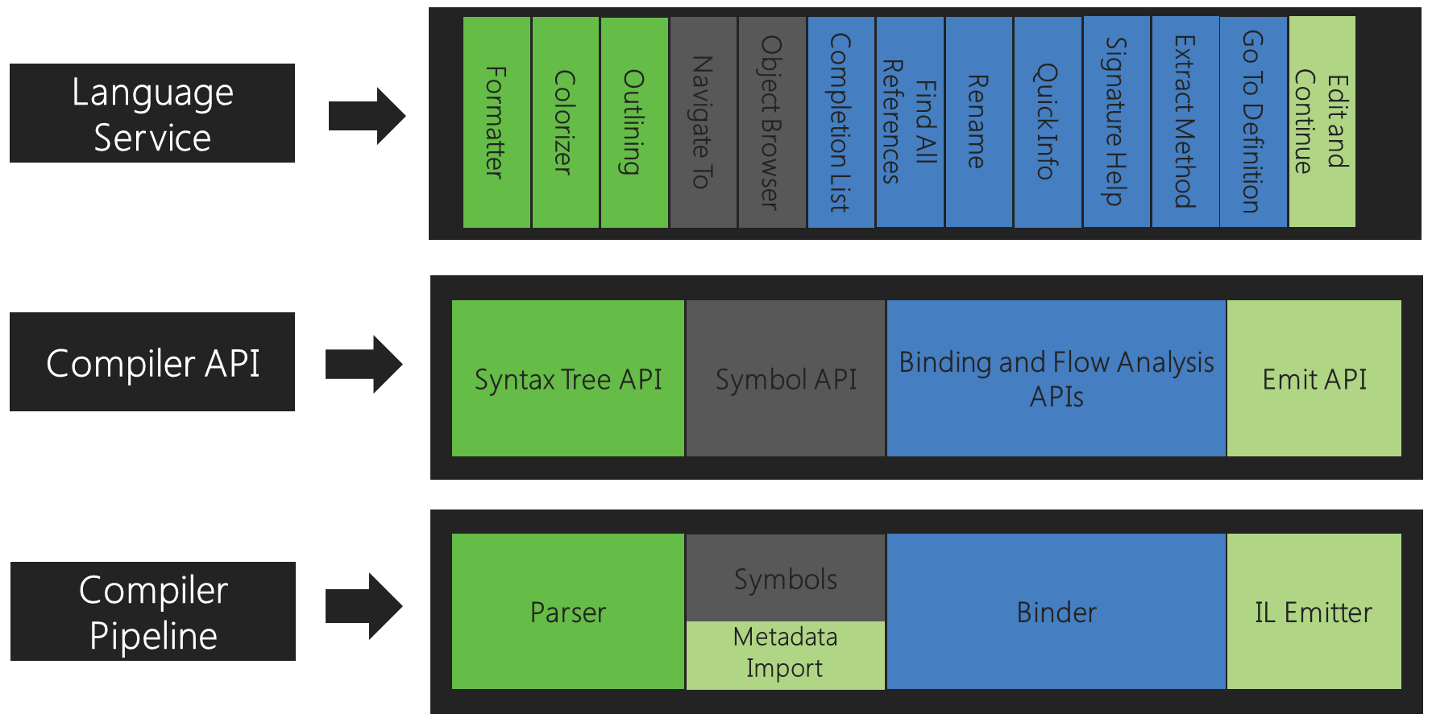
Let’s add some flavour...
Notes:
Language service with Roslyn is depending on compiler apis. So what you see on the IDE its actually compiler lvl meta data usage. Its not language dependent if Roslyn can compile the code you can get that meta data. Its way faster than loading the file and performing optimisation on the fly

Slide 8
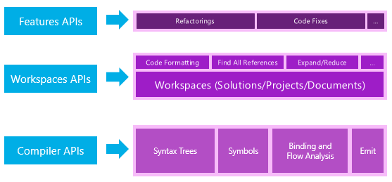
Roslyn APIs
Notes:
Compiler APIs - object models for the popeline refs,source code etc.
Diagnostic APIs – produce diagnostics , syntax, semantic, and definite assignment errors to various warnings and informational
Scripting APIs - hosting/scripting execution context
Workspaces APIs - code analysis and refactoring over entire solutions, compiler layer object models without needing to parse files,

Slide 9
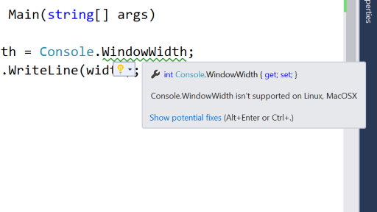
Analyzers
An analysis tool where you can produce diagnostics information and perform code changes.
Integrated with your IDE ( not just Visual Studio )

Slide 10
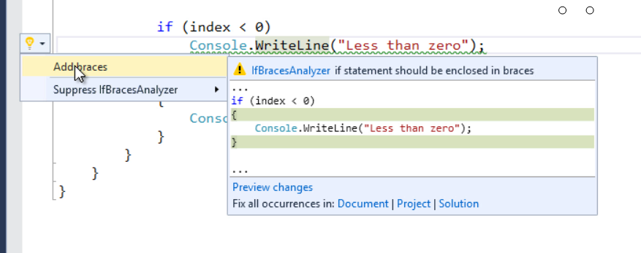
Code Fixers

Slide 11
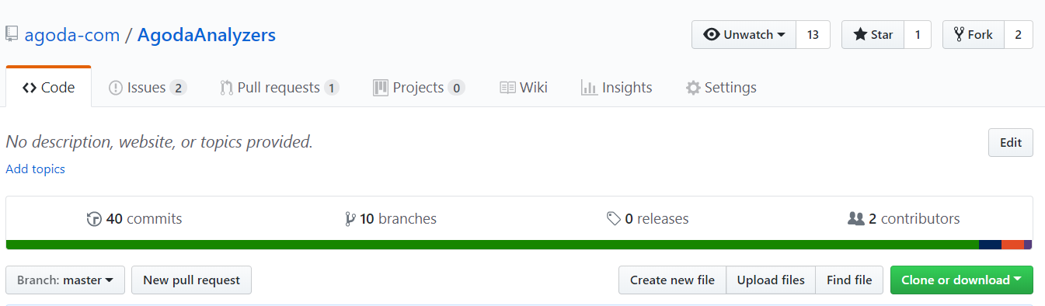
Agoda Analyzer Project On Github.com

Slide 12
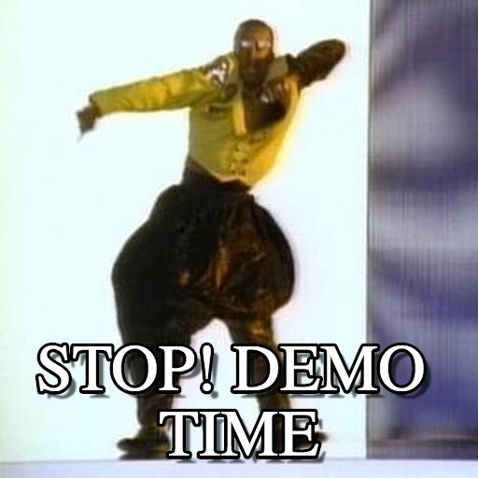

Slide 13


Slide 14
Build Pipeline
Github Integration and PRs
Sonarqube server reporting
Other tooling
BUT…
We are trying to make the developer experience better so we don’t want to add blockers, we would rather remove them

Slide 15

YOU SHALL NOT PASS
THE CI BUILD

Slide 16

Code Gatekeepers
When we block we need to empower the developer to unblock himself
Tools that block people are annoying
Your code sucks, try again
Tools that educate people are better
Your code sucks, Improve your code this way
Tools that fix it for you are the best
Your code sucks, Click here to make your code better

Slide 17

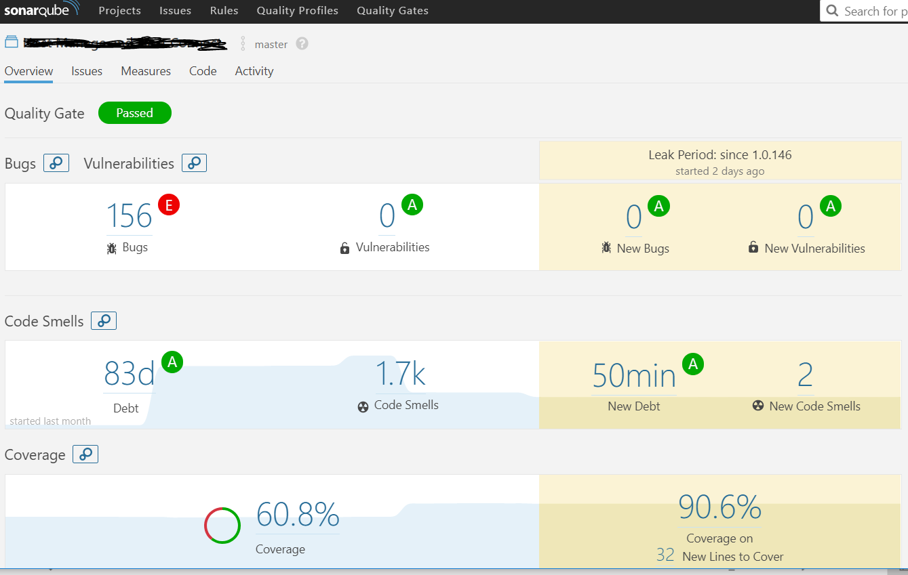
Sonarqube
Is a code analysis server that supports 20 languages

Slide 18

And it’s a giant pain in the ass because it supports 20 languages

Slide 19
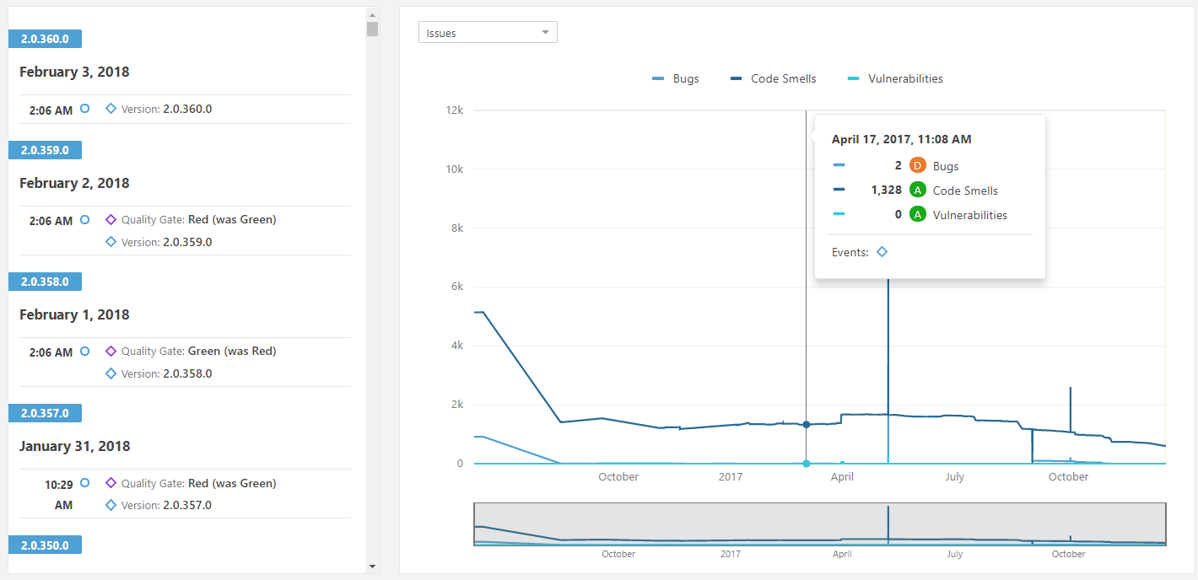
Sonarqube – Standardized Reporting
Reporting
Visibility is important

Slide 20
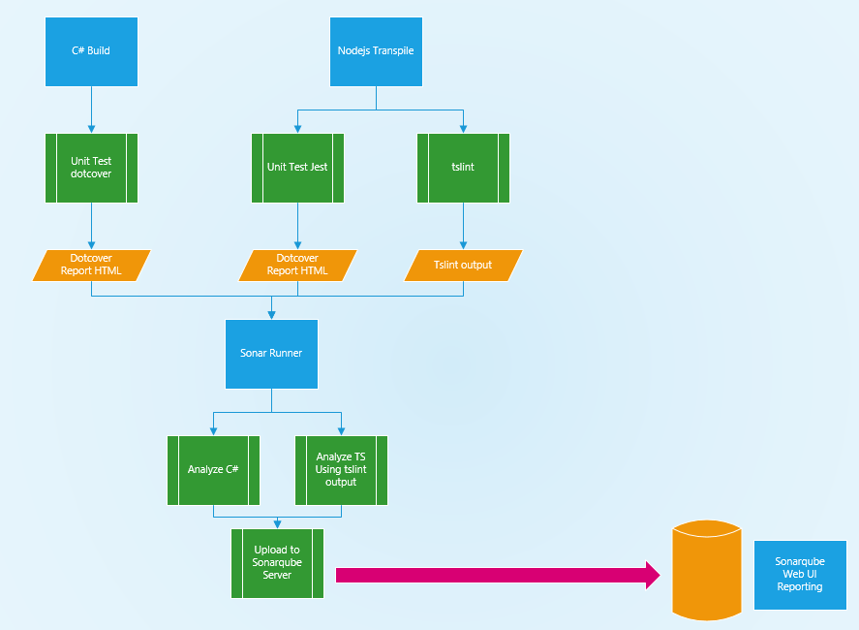
How processing works
Output form 2 languages
Combines into single Report for the project
https://beerandserversdontmix.com/2018/02/03/sonarqube-with-a-multilanguage-project-typescript-and-dotnet/

Slide 21
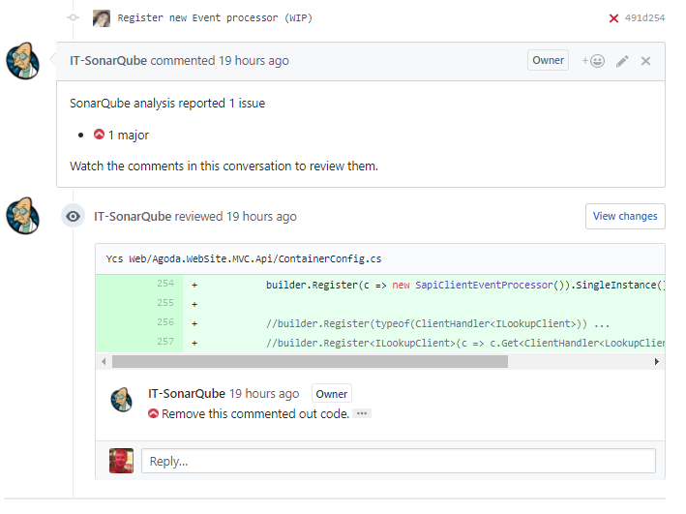
Sonarqube – GitHub Integration
The code review Bot
Failures on changed code in PR are comment against
ONLY CHANGED CODE FILES
Culture: Leave things in a better place than you found them
Commit Status message can block merge to master
http://techblog.jetabroad.com/2016/06/increasing-code-quality-with-sonarqube.html

Slide 22

Your rules into Sonarqube
Roslyn Analyzers projects produce a nuget Analyzer NUPKG file
This is install like a regular nupkg into your solution/project
Sonarqube plugins are a JAR file input
Square plug round hole?
Enter => Sonarqube Roslyn SDK
https://github.com/agoda-com/sonarqube-roslyn-sdk
Command line tool that converts NUPKG to JAR
Roslyn requires more meta data as well…

Slide 23
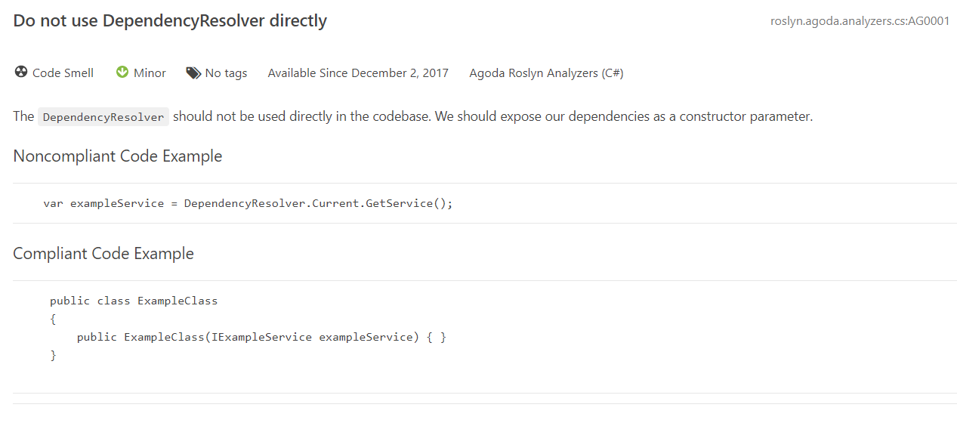
Meta Data fields for Roslyn

Slide 24
How stuff works?
GitHub.com Project builds nuget
IDEs consume nuget
Publish to nuget.org triggers onprem build
Builds JAR and uploads to octopus Deploy
Deploy to Sonarqube server
Octopus copy JAR file into place, reboots sonar and smoke test (rolls back if fails)

Slide 25
How to get started
Install Sonarqube (it’s free) and comes with good default rules
Setup GitHub integration with TeamCity (or your build tool)
Install Agoda Analyzer Rules
It will find LOTS of code smells

Slide 26

Worried you’ll get 2 million Errors when you Install?

Slide 27
Start by Stopping the leak
Code review bot looks at only files changed
Start here
Use the reporting in Sonarqube to track your progress
Slow down, over estimate your stories to account for refactoring
Fix/refactor things as you go
Eventually you’ll get there

Slide 28

Results – Happy Developers

Slide 29
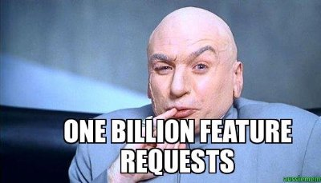
Results – Happy Product Owners

Slide 30
Questions?

